Slide 1
CSE302: Computer Networks Project
TITLE
FTPS CLIENT-SERVER APPLICATION WITH
AES ENCRYPTION USING DIFFIE-HELLMAN KEY EXCHANGE
PRESENTED BY :
NAME : CHITRALA VARUN TEJA
REG NO : 124157012
CSE CYBER SECURITY AND BLOCKCHAIN TECHNOLOGY
Guide Name: Dr. R. Kavitha, CSE/SoC, SASTRA University
Date of Presentation: 26.11.2022
1

Slide 2
Points to be discussed
Aim & Objective.
Problem Statement & Solution.
System Configuration: Platform, Software, Network type, Protocols used.
Work Flow Diagram.
Proposed Protocol Description.
Work Done (Implementation code link).
Sample I/O (screenshot).
References.

Slide 3
AIM & OBJECTIVES
The aim of the project is implementing the FTPS protocol for producing security of files over TCP/IP based Network on Client-Sever environment.
Objective 1: understanding FTPS,SFTP protocols
Objective 2: implementing the protocols using java
Objective 3: Creating windows application using java

Slide 4

Problem Statement & Solution
PROBLEM STATEMENT
Need of data security over network in Client-Server environment.
SOLUTION
Implementing FTPS protocol using java.
Implementing AES ciphering algorithm for encryption of files.
Implementing Diffie-Helman key for exchanging symmetric encryption keys without being spoofed.

Slide 5
System configuration
Client
- Platform: Windows
- Software used :
Java 18.0.1.1 Eclipse 4.12
- Network: Wireless
- Protocol : FTPS
Server
Network: wireless
Protocol : FTPS

Slide 6
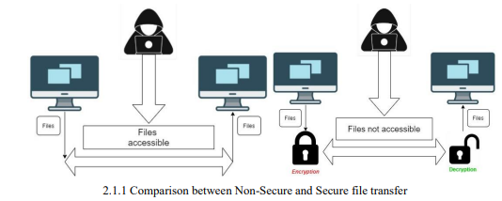
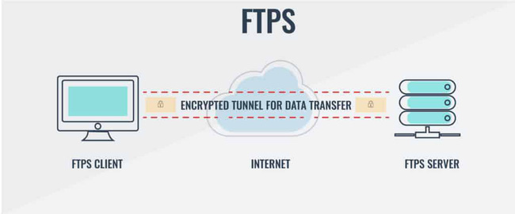
Network Architecture: Client - Server
Work Flow Diagram

Slide 7
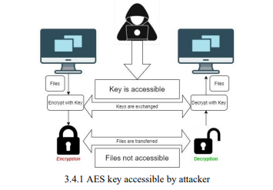

FLOWCHART : PROBLEM DUE TO REQUIREMENT OF SYMMETRIC KEY.

Slide 8
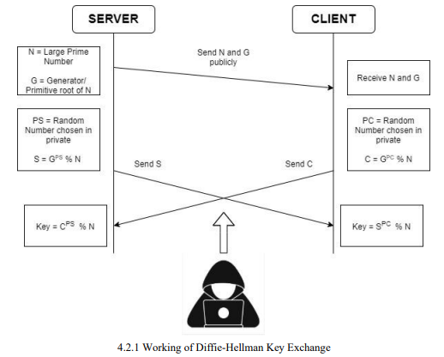
FLOWCHART : Working of Key Exchange

Slide 9
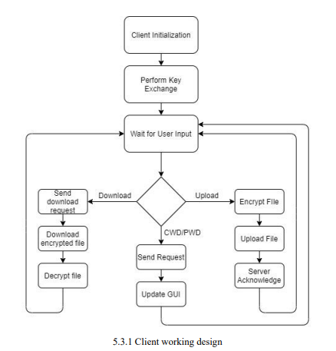
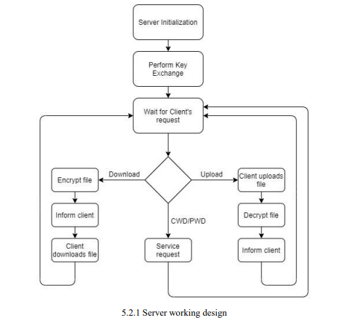
FLOWCHART : IMPLEMENTING ENCRYPTION IN CLIENT SIDE AND SERVER SIDE

Slide 10
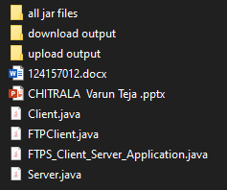
Work done so far
Jar files for headers
Output Folder for downloaded files
Output folder for uploaded files
File to be transferred
Project PPT
Code of FTPS
Link for implemented code:
https://drive.google.com/drive/folders/12U5tF3mw9lne-yGFb8ZM745FOUg_OWPE?usp=share_link

Slide 11
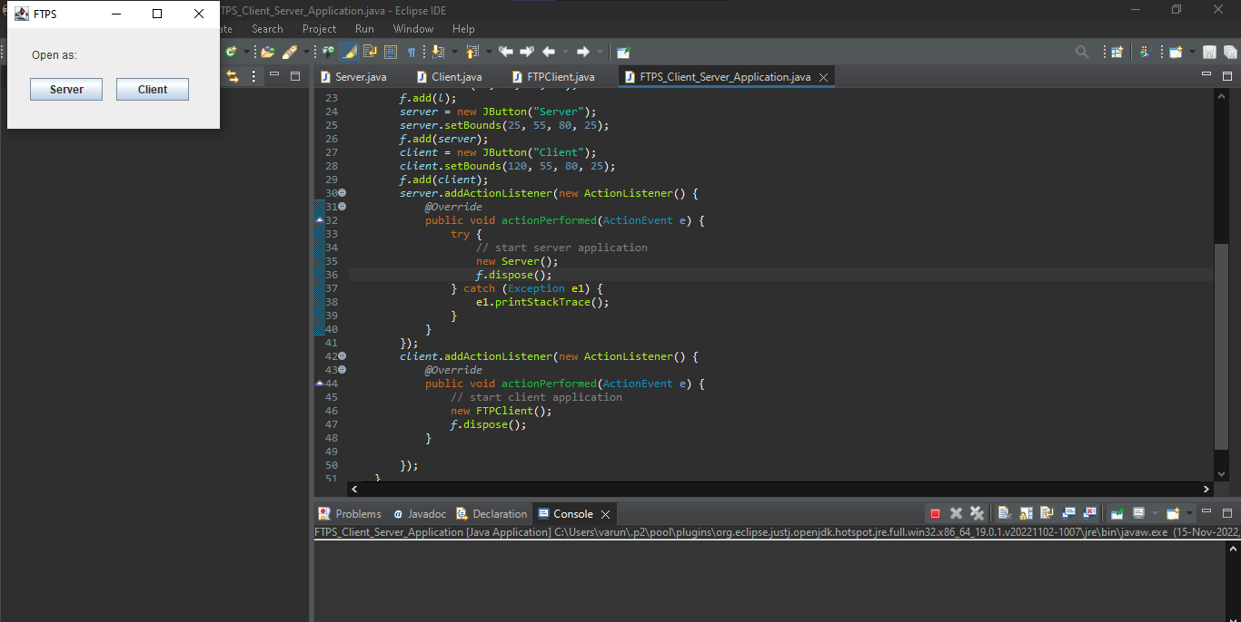

Slide 12
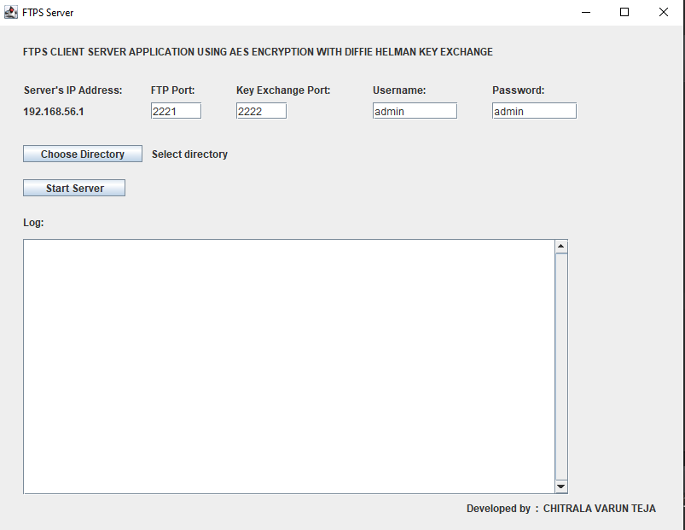
1st choose a folder
And then START SERVER

Slide 14
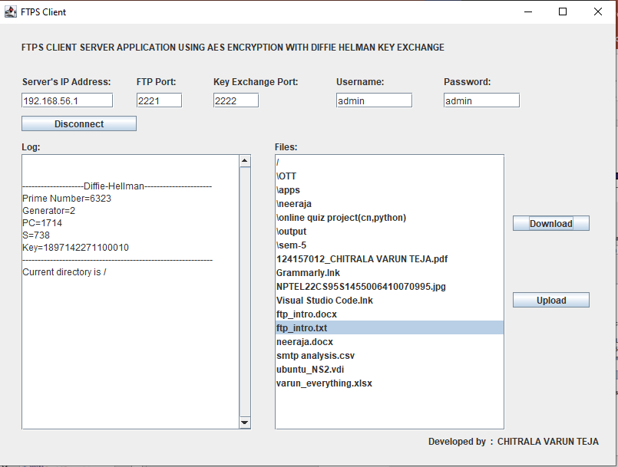

Give SERVER IP address
And then CONNECT to the server

Slide 15
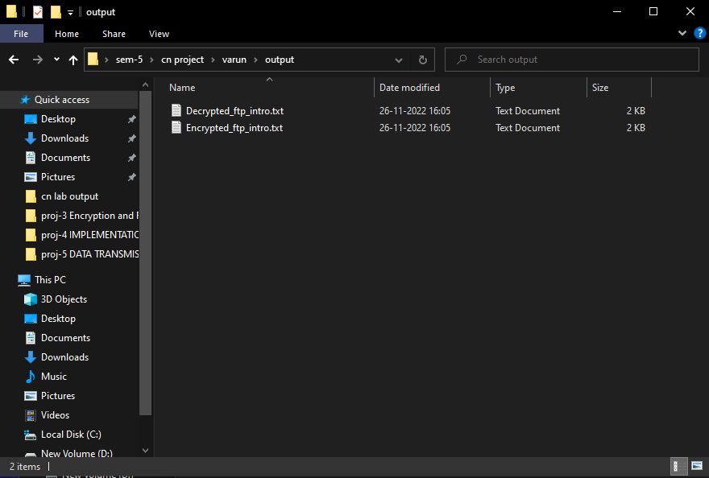
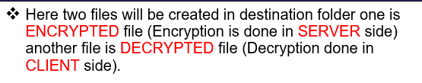
Sample I/O screen shots
DOWNLOAD a file from SERVER

Slide 16
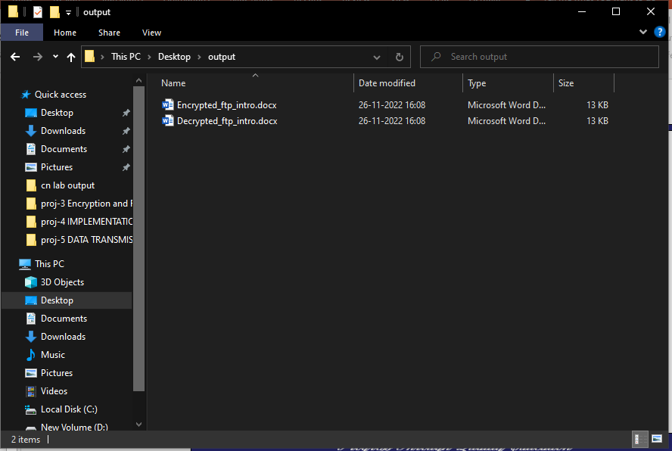
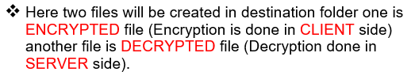
Similarly we can UPLOAD a file to SERVER from CLIENT.
UPLOAD a file to SERVER.

Slide 17
References
15
James F. Kurose, Keith W. Ross “Computer networking A top-down approach” 7th edition.
Apache FTP Server Documentation - FtpServer Documentation — Apache MINA
Apache Commons Net FTP Client - FTPClient (Commons Net 1.4.1 API) (apache.org)
AES - Advanced Encryption Standard – Wikipedia.
AES Key Schedule - AES key schedule – Wikipedia.
Diffie Hellman Key Exchange”- cryptography - "Diffie-Hellman Key Exchange" in plain English - Information Security Stack Exchange

Slide 18
17
Thank You

